Slide 4
Notes:
Cross Promotion
Enhanced audio and video
Low cost barrier
entertaining and knowledgeable commentators

Slide 5
Notes:
Cross Promotion
Enhanced audio and video
Low cost barrier
entertaining and knowledgeable commentators

Slide 6
Notes:
Cross Promotion
Enhanced audio and video
Low cost barrier
entertaining and knowledgeable commentators

Slide 7
Notes:
Cross Promotion
Enhanced audio and video
Low cost barrier
entertaining and knowledgeable commentators

Slide 8
Notes:
Cross Promotion
Enhanced audio and video
Low cost barrier
entertaining and knowledgeable commentators

Slide 9
Notes:
shift from traditional cable
viewers multitask
UFC on the rise
FOX Sports website is hard to navigate

Slide 10
Notes:
shift from traditional cable
viewers multitask
UFC on the rise
FOX Sports website is hard to navigate

Slide 11
Notes:
shift from traditional cable
viewers multitask
UFC on the rise
FOX Sports website is hard to navigate

Slide 12
Notes:
shift from traditional cable
viewers multitask
UFC on the rise
FOX Sports website is hard to navigate

Slide 13
Notes:
shift from traditional cable
viewers multitask
UFC on the rise
FOX Sports website is hard to navigate

Slide 14
Notes:
1- undefeated champs, those trying to make new achievements, youngest fighters-age 19; strong marketability
2- available on Fox and FS1 and Fox Deportes
3- backstory is captivating to those watching
4- Inside PBC Boxing, youtube, etc.

Slide 15
Notes:
1- undefeated champs, those trying to make new achievements, youngest fighters-age 19; strong marketability
2- available on Fox and FS1 and Fox Deportes
3- backstory is captivating to those watching
4- Inside PBC Boxing, youtube, etc.

Slide 16
Notes:
1- undefeated champs, those trying to make new achievements, youngest fighters-age 19; strong marketability
2- available on Fox and FS1 and Fox Deportes
3- backstory is captivating to those watching
4- Inside PBC Boxing, youtube, etc.

Slide 17
Notes:
1- undefeated champs, those trying to make new achievements, youngest fighters-age 19; strong marketability
2- available on Fox and FS1 and Fox Deportes
3- backstory is captivating to those watching
4- Inside PBC Boxing, youtube, etc.

Slide 18
Notes:
1- undefeated champs, those trying to make new achievements, youngest fighters-age 19; strong marketability
2- available on Fox and FS1 and Fox Deportes
3- backstory is captivating to those watching
4- Inside PBC Boxing, youtube, etc.

Slide 19
Notes:
1- McGregor is in UFC
2- viewership loss in cable
3- 3% said they are current boxing fans
4- losing money for PPV fights and cannot track them as much to gain insight for research

Slide 20
Notes:
1- McGregor is in UFC
2- viewership loss in cable
3- 3% said they are current boxing fans
4- losing money for PPV fights and cannot track them as much to gain insight for research

Slide 21
Notes:
1- McGregor is in UFC
2- viewership loss in cable
3- 3% said they are current boxing fans
4- losing money for PPV fights and cannot track them as much to gain insight for research

Slide 22
Notes:
1- McGregor is in UFC
2- viewership loss in cable
3- 3% said they are current boxing fans
4- losing money for PPV fights and cannot track them as much to gain insight for research

Slide 23
Notes:
1- McGregor is in UFC
2- viewership loss in cable
3- 3% said they are current boxing fans
4- losing money for PPV fights and cannot track them as much to gain insight for research

Slide 24
Notes:
11 total networks and broadcasts
Highest viewership ever in 2017
Invest in sports that drive high traffic
Quickly adapt to digital trends
the bottom one is deleted

Slide 25
Notes:
11 total networks and broadcasts
Highest viewership ever in 2017
Invest in sports that drive high traffic
Quickly adapt to digital trends
the bottom one is deleted

Slide 26
Notes:
11 total networks and broadcasts
Highest viewership ever in 2017
Invest in sports that drive high traffic
Quickly adapt to digital trends
the bottom one is deleted

Slide 27
Notes:
11 total networks and broadcasts
Highest viewership ever in 2017
Invest in sports that drive high traffic
Quickly adapt to digital trends
the bottom one is deleted

Slide 28
Notes:
11 total networks and broadcasts
Highest viewership ever in 2017
Invest in sports that drive high traffic
Quickly adapt to digital trends
the bottom one is deleted

Slide 29
Notes:
Need to CORRECT this stat. It should read: a 5% increase in spending in estimated for the industry over the next 5 years.
Viewership depends on fight-match ups
A lot of ways to watch boxing
Seasonality = no factor
Marketing on TV and social media

Slide 30
Notes:
Need to CORRECT this stat. It should read: a 5% increase in spending in estimated for the industry over the next 5 years.
Viewership depends on fight-match ups
A lot of ways to watch boxing
Seasonality = no factor
Marketing on TV and social media

Slide 31
Notes:
Need to CORRECT this stat. It should read: a 5% increase in spending in estimated for the industry over the next 5 years.
Viewership depends on fight-match ups
A lot of ways to watch boxing
Seasonality = no factor
Marketing on TV and social media

Slide 32
Notes:
Need to CORRECT this stat. It should read: a 5% increase in spending in estimated for the industry over the next 5 years.
Viewership depends on fight-match ups
A lot of ways to watch boxing
Seasonality = no factor
Marketing on TV and social media

Slide 33
Notes:
Need to CORRECT this stat. It should read: a 5% increase in spending in estimated for the industry over the next 5 years.
Viewership depends on fight-match ups
A lot of ways to watch boxing
Seasonality = no factor
Marketing on TV and social media

Slide 34
Notes:
Need to CORRECT this stat. It should read: a 5% increase in spending in estimated for the industry over the next 5 years.
Viewership depends on fight-match ups
A lot of ways to watch boxing
Seasonality = no factor
Marketing on TV and social media

Slide 35
Notes:
Median age: 47
did this one make it on the final?
70% more likely to watch a gave they bet on
NBA fans 135% more likely to watch boxing
72% men, 28% women
some of these i cant remmeber if are on there, like this one
Watching sports events out of home with groups of 3-4 people

Slide 36
Notes:
Median age: 47
did this one make it on the final?
70% more likely to watch a gave they bet on
NBA fans 135% more likely to watch boxing
72% men, 28% women
some of these i cant remmeber if are on there, like this one
Watching sports events out of home with groups of 3-4 people

Slide 37
Notes:
Median age: 47
did this one make it on the final?
70% more likely to watch a gave they bet on
NBA fans 135% more likely to watch boxing
72% men, 28% women
some of these i cant remmeber if are on there, like this one
Watching sports events out of home with groups of 3-4 people

Slide 38
Notes:
Median age: 47
did this one make it on the final?
70% more likely to watch a gave they bet on
NBA fans 135% more likely to watch boxing
72% men, 28% women
some of these i cant remmeber if are on there, like this one
Watching sports events out of home with groups of 3-4 people

Slide 39
Notes:
Median age: 47
did this one make it on the final?
70% more likely to watch a gave they bet on
NBA fans 135% more likely to watch boxing
72% men, 28% women
some of these i cant remmeber if are on there, like this one
Watching sports events out of home with groups of 3-4 people

Slide 40
Notes:
Median age: 47
did this one make it on the final?
70% more likely to watch a gave they bet on
NBA fans 135% more likely to watch boxing
72% men, 28% women
some of these i cant remmeber if are on there, like this one
Watching sports events out of home with groups of 3-4 people

Slide 41
Notes:
ESPN, NBC Sports and DAZN
UFC and WWE
History and quality of fighters
Sports viewers arent engaged
make these numbers big or get rid of completely because we already discussed this in previous slides

Slide 42
Notes:
ESPN, NBC Sports and DAZN
UFC and WWE
History and quality of fighters
Sports viewers arent engaged
make these numbers big or get rid of completely because we already discussed this in previous slides

Slide 43
Notes:
ESPN, NBC Sports and DAZN
UFC and WWE
History and quality of fighters
Sports viewers arent engaged
make these numbers big or get rid of completely because we already discussed this in previous slides

Slide 44
Notes:
ESPN, NBC Sports and DAZN
UFC and WWE
History and quality of fighters
Sports viewers arent engaged
make these numbers big or get rid of completely because we already discussed this in previous slides

Slide 45
Notes:
ESPN, NBC Sports and DAZN
UFC and WWE
History and quality of fighters
Sports viewers arent engaged
make these numbers big or get rid of completely because we already discussed this in previous slides

Slide 46
Notes:
ESPN, NBC Sports and DAZN
UFC and WWE
History and quality of fighters
Sports viewers arent engaged
make these numbers big or get rid of completely because we already discussed this in previous slides

Slide 48
Notes:
split these into 2 slides

Slide 49
Notes:
split these into 2 slides

Slide 50
Notes:
split these into 2 slides

Slide 51
Notes:
split these into 2 slides

Slide 52
Notes:
split these into 2 slides

Slide 53
Notes:
split these into 2 slides

Slide 54
Notes:
split these into 2 slides

Slide 55
Notes:
this is fine
this is fine
“intense”, “entertaining”, “rough,” “action-packed”
Big name fights & fighters’ skill levels
38% of prospects are interested in watching

Slide 56
Notes:
this is fine
this is fine
“intense”, “entertaining”, “rough,” “action-packed”
Big name fights & fighters’ skill levels
38% of prospects are interested in watching

Slide 57
Notes:
this is fine
this is fine
“intense”, “entertaining”, “rough,” “action-packed”
Big name fights & fighters’ skill levels
38% of prospects are interested in watching

Slide 58
Notes:
this is fine
this is fine
“intense”, “entertaining”, “rough,” “action-packed”
Big name fights & fighters’ skill levels
38% of prospects are interested in watching

Slide 59
Notes:
this is fine
this is fine
“intense”, “entertaining”, “rough,” “action-packed”
Big name fights & fighters’ skill levels
38% of prospects are interested in watching

Slide 60
Notes:
this is fine
this is fine
“intense”, “entertaining”, “rough,” “action-packed”
Big name fights & fighters’ skill levels
38% of prospects are interested in watching

Slide 61
Notes:
this is fine
this is fine
“intense”, “entertaining”, “rough,” “action-packed”
Big name fights & fighters’ skill levels
38% of prospects are interested in watching

Slide 65
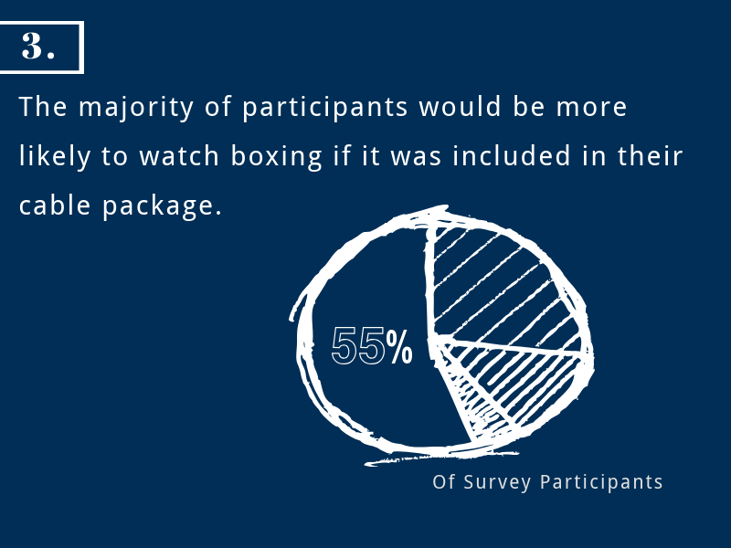

Slide 73
Notes:
Boxing as a PPV sport
Not willing to pay a premium
Not familiar with how sport works and don’t know fighters
Boxing is social

Slide 74
Notes:
Boxing as a PPV sport
Not willing to pay a premium
Not familiar with how sport works and don’t know fighters
Boxing is social

Slide 75
Notes:
Boxing as a PPV sport
Not willing to pay a premium
Not familiar with how sport works and don’t know fighters
Boxing is social

Slide 76
Notes:
Boxing as a PPV sport
Not willing to pay a premium
Not familiar with how sport works and don’t know fighters
Boxing is social

Slide 77
Notes:
Boxing as a PPV sport
Not willing to pay a premium
Not familiar with how sport works and don’t know fighters
Boxing is social

Slide 78
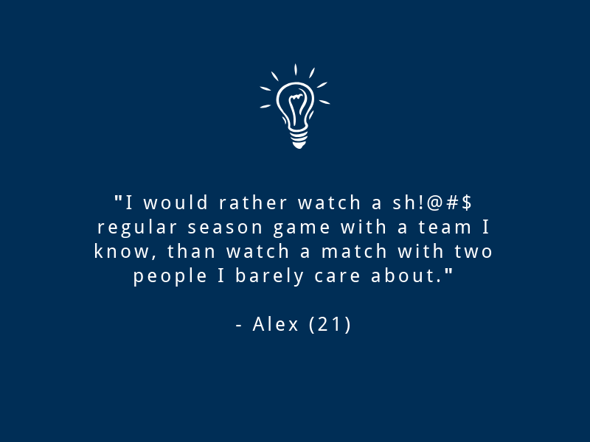
Notes:
fix shitty

Slide 79
Notes:
Commentators understand the sport
Enjoy the way fighters in the UFC are promoted
Backstories make a boxer more desirable
PPV is a barrier
Watch matches in social settings

Slide 80
Notes:
Commentators understand the sport
Enjoy the way fighters in the UFC are promoted
Backstories make a boxer more desirable
PPV is a barrier
Watch matches in social settings

Slide 81
Notes:
Commentators understand the sport
Enjoy the way fighters in the UFC are promoted
Backstories make a boxer more desirable
PPV is a barrier
Watch matches in social settings

Slide 82
Notes:
Commentators understand the sport
Enjoy the way fighters in the UFC are promoted
Backstories make a boxer more desirable
PPV is a barrier
Watch matches in social settings

Slide 83
Notes:
Commentators understand the sport
Enjoy the way fighters in the UFC are promoted
Backstories make a boxer more desirable
PPV is a barrier
Watch matches in social settings

Slide 84
Notes:
Commentators understand the sport
Enjoy the way fighters in the UFC are promoted
Backstories make a boxer more desirable
PPV is a barrier
Watch matches in social settings

Slide 85
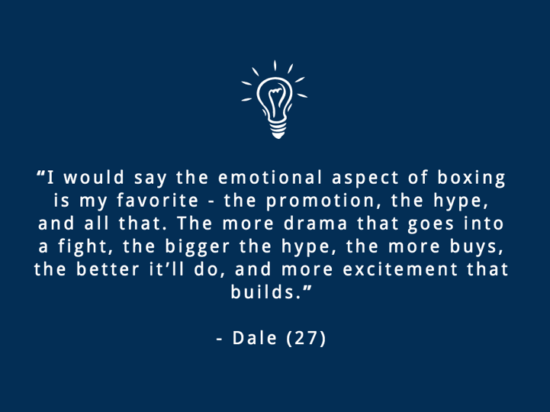

Slide 95
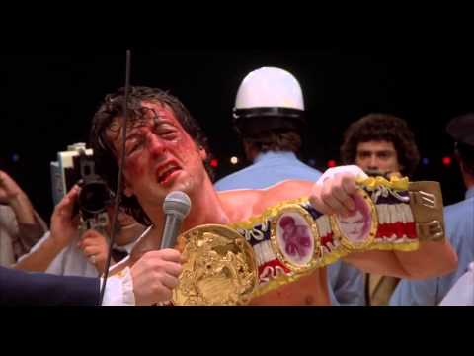

Slide 97
